Slide 1


Text Mining arXiv: A Look Through Quantitative Finance Papers
Analysis of 16,000+ Papers (1997-2022)

Slide 2
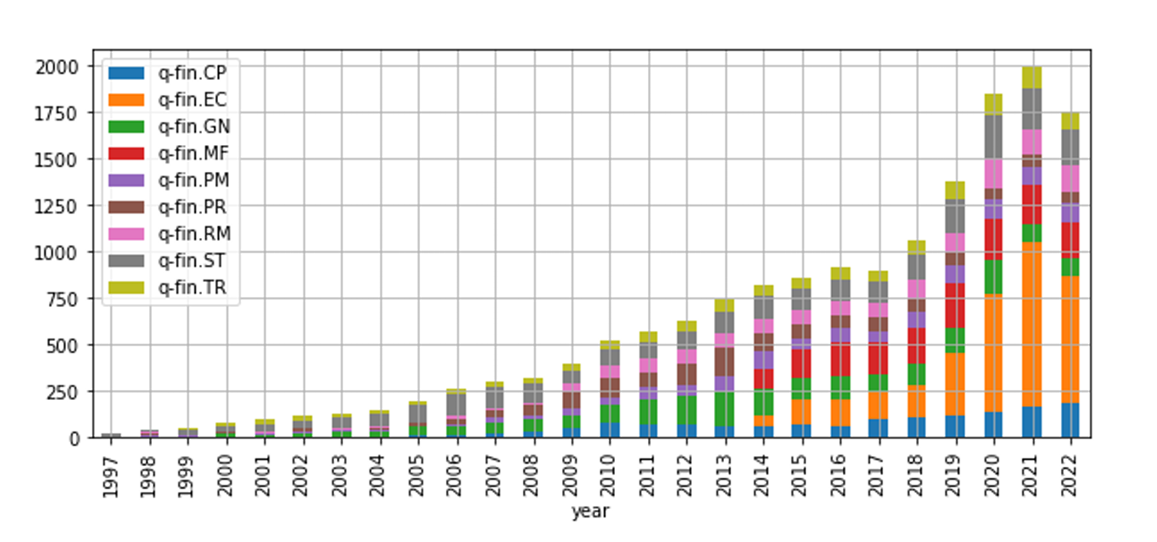
Research Overview
Comprehensive analysis of arXiv's quantitative finance papers
Text mining and natural language processing approach
Focus on topic trends and influential researchers
Period: 1997-2022

Slide 3
Quantitative Finance Categories
Computational Finance (Monte Carlo, PDEs)
Economics (Micro/Macro)
General Finance
Mathematical Finance
Portfolio Management
Securities Pricing
Risk Management
Statistical Finance
Trading/Market Microstructure

Slide 4
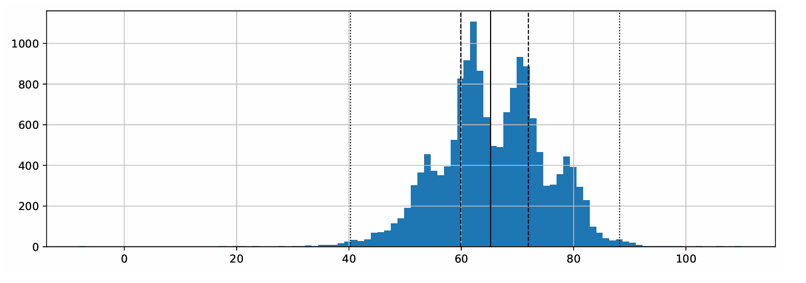
Paper Analysis Metrics
Median paper length: 8,824 words
Readability Analysis:Average Flesch score: 65.7 (Plain English)
Range: 40.28 (Difficult) to 88.20 (Easy)

Slide 5
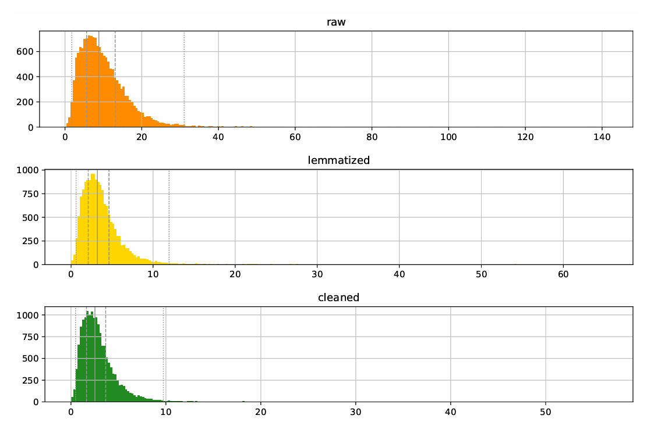
Text Processing Pipeline
Document tokenization
Year extraction
Word identification
Stopword removal
Lemmatization
Language detection

Slide 6
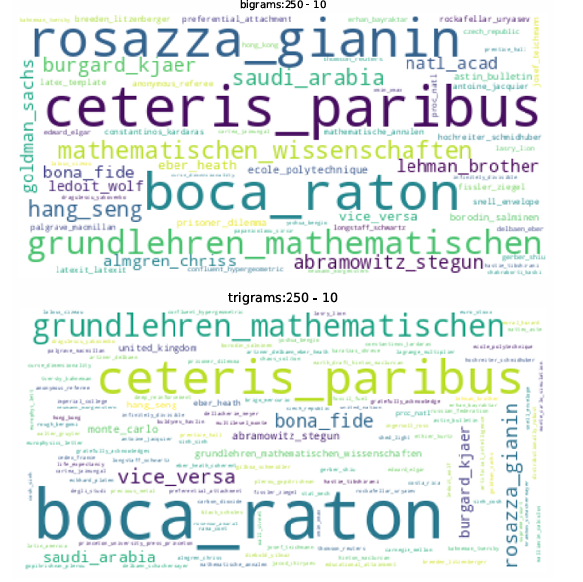
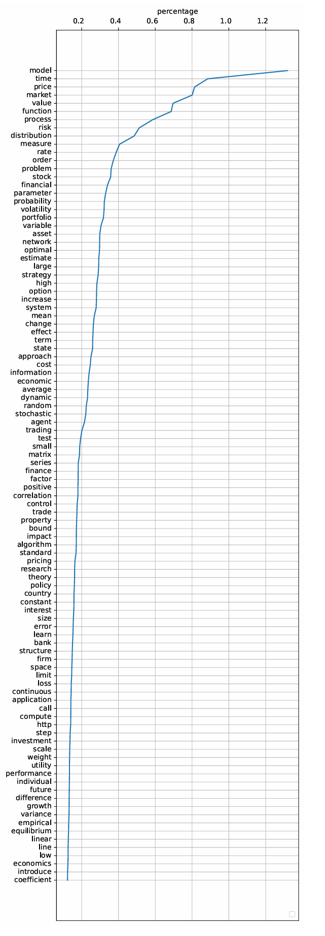
Common Terms & Phrases
Most frequent words and their occurrence rates
Key bigrams and trigrams in research

Slide 7
Topic Modeling Approaches
K-means clustering
Latent Dirichlet Allocation (LDA)
Word2Vec and Doc2Vec
Top2Vec
BERTopic

Slide 8
Key Findings
Doc2Vec outperformed other models
Significant growth in economics papers
"Model" appears every ~100 words
Strong presence of mathematical and technical terminology

Slide 9
Research Evolution
Growth trends across categories
Shift in research focus over 25 years
Impact of technological advances
Emergence of new financial topics

Slide 10
Future Directions
Potential for expanded analysis
Applications in research trend prediction
Opportunities for deeper semantic analysis
Integration with other research databases

